Slide 1

Unsupervised Learning
Introduction to The Different Approach in
Mining The Underlying Structure of
The Unlabeled Data Under A Certain Context &
Their Possible Application
林成鍇 Julius Ling @ 國立成功大學大數據與AI研究中心

Slide 2

Unsupervised Learning and Psychometrics
Phenomenon
Noumenon
(a.k.a Ding an Sich)

Slide 3
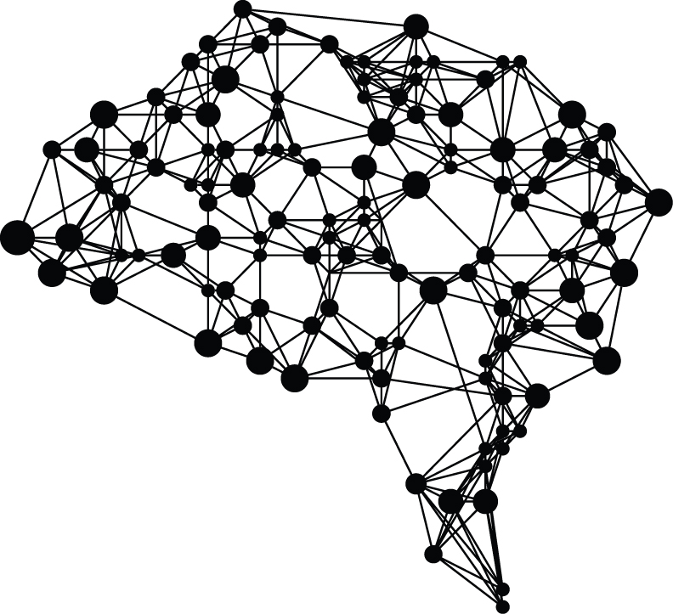
Outline
Jargons Clarification
Clustering Task & Generative Model
Dimensionality Reduction
Structural Modelling

Slide 4
Outline
Jargons Clarification
Clustering Task & Generative Model
Dimensionality Reduction
Structural Modelling

Slide 5
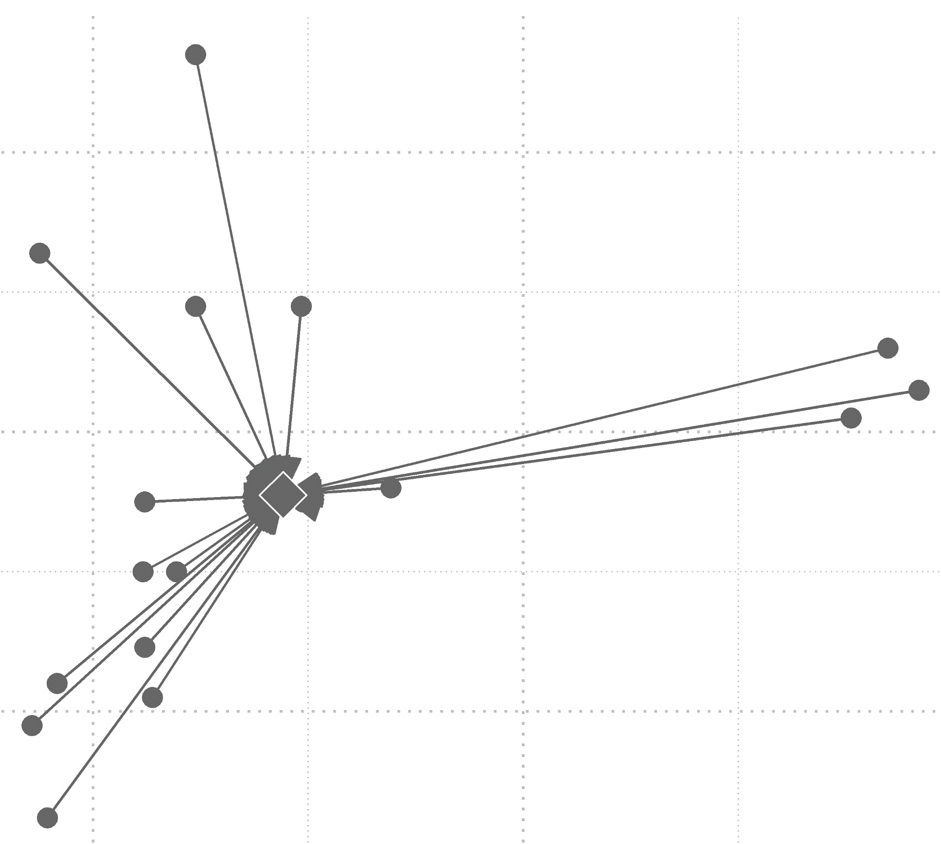
Jargons Clarification
Unsupervised Learning
Clustering Task
Discriminative Model & Generative Model
Dimensionality Reduction & Manifold Learning

Slide 6
Jargons Clarification
Unsupervised Learning
Clustering Task
Discriminative Model & Generative Model
Dimensionality Reduction & Manifold Learning

Slide 7
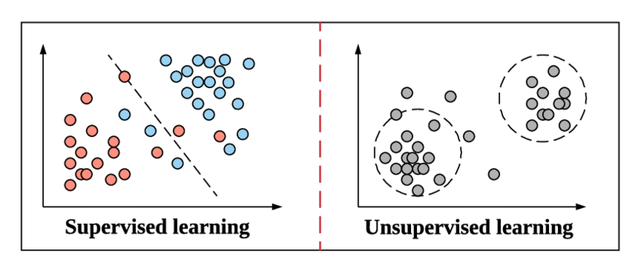
Recall: Unsupervised Learning

Slide 8
Conventional Definition of in Data Science
An unsupervised model, in contrast, provides unlabeled data that the algorithm tries to make sense of by extracting features and patterns on its own.
https://blogs.nvidia.com/blog/2018/08/02/supervised-unsupervised-learning/#:~:text=In%20a%20supervised%20learning%20model,and%20patterns%20on%20its%20own.

Slide 9
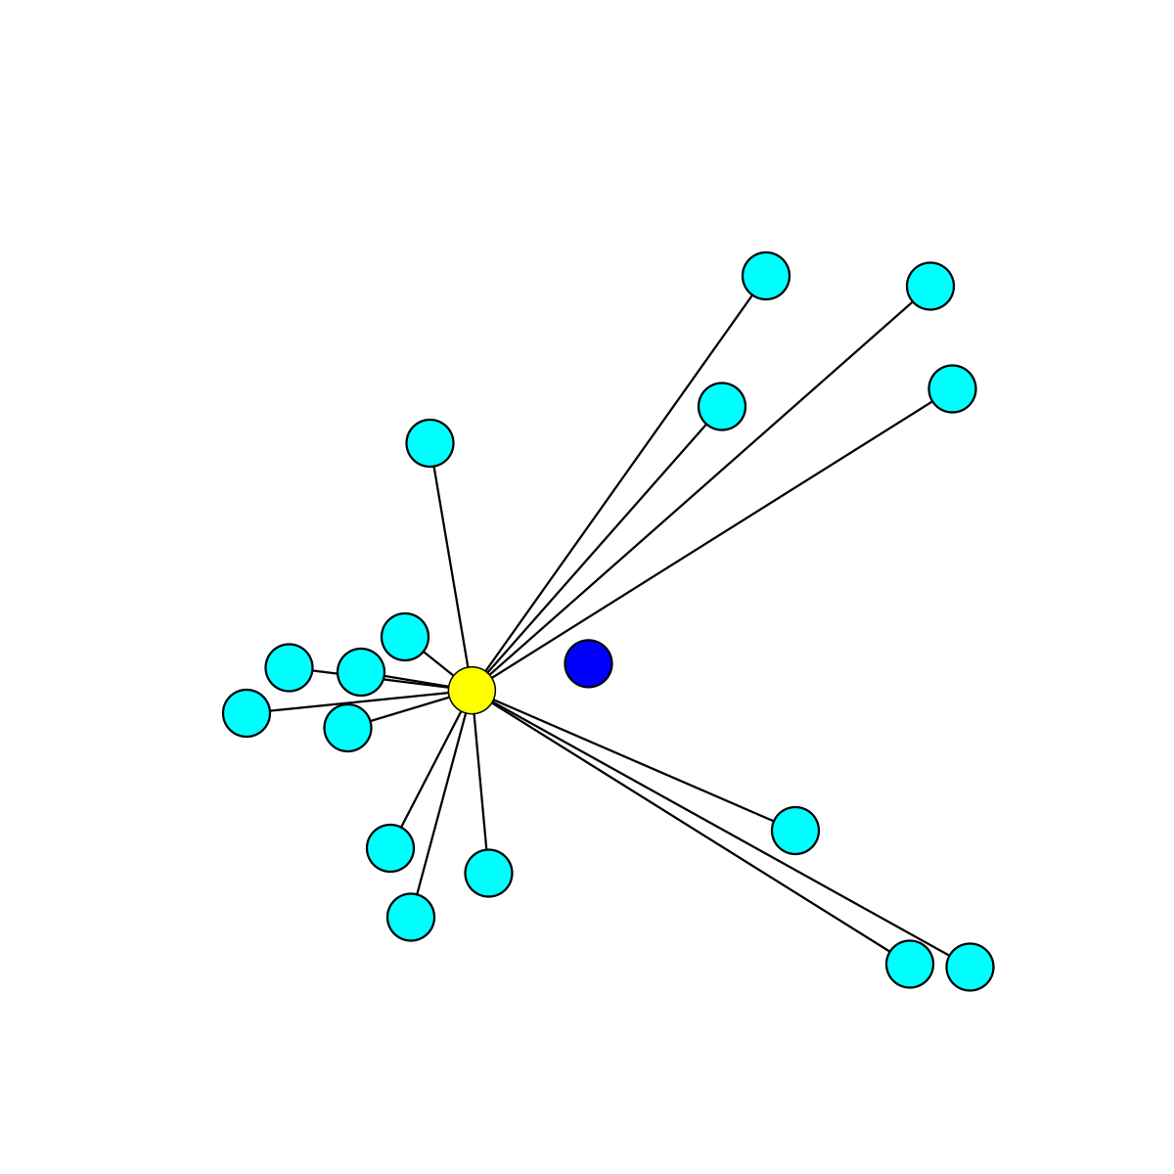
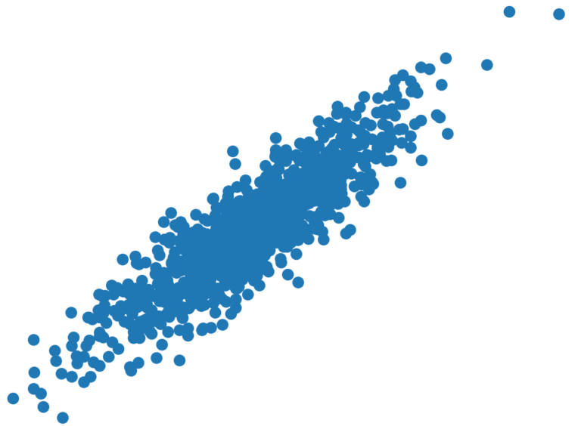
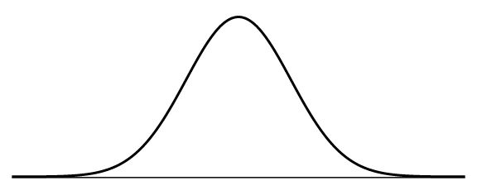
… features and patterns …
It could be of certain probability distribution, geometric distance or statistics.

Slide 10
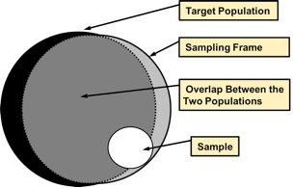
… of its own
It depends GREATLY on your presumption and your sampling frame.

Slide 11
Jargons Clarification
Unsupervised Learning
Clustering Task
Discriminative Model & Generative Model
Dimensionality Reduction & Manifold Learning

Slide 12
Clustering
Cluster analysis or clustering is the task of grouping a set of objects in such a way that objects in the same group (called a cluster) are more similar (in some sense) to each other than to those in other groups (clusters).
~ Adapted from Wikipedia

Slide 13
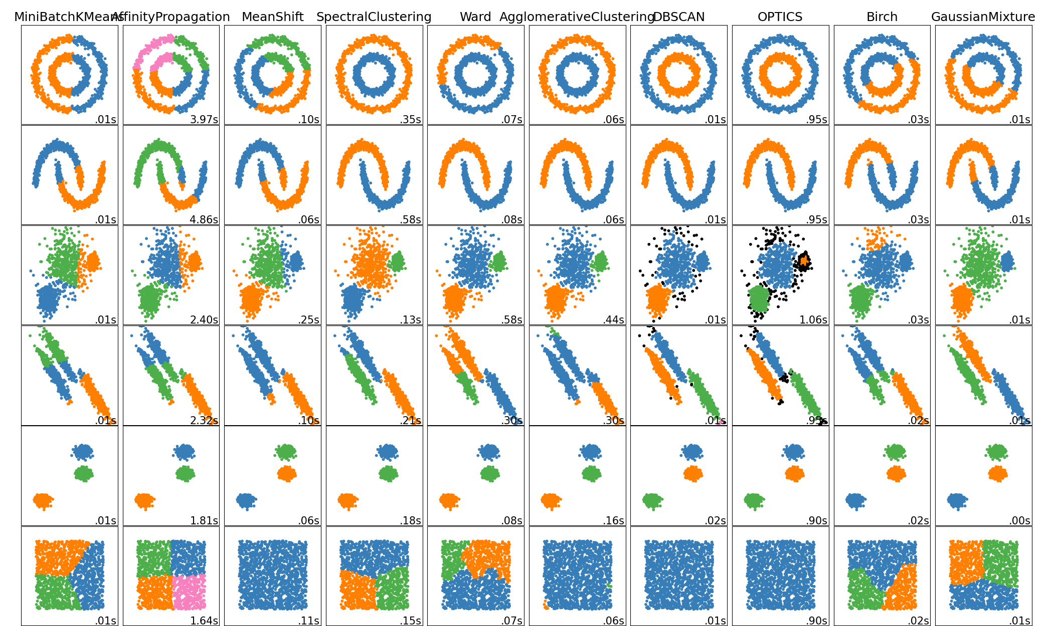
Source: https://scikit-learn.org/stable/modules/clustering.html

Slide 14
Jargons Clarification
Unsupervised Learning
Clustering Task
Discriminative Model & Generative Model
Dimensionality Reduction & Manifold Learning

Slide 15
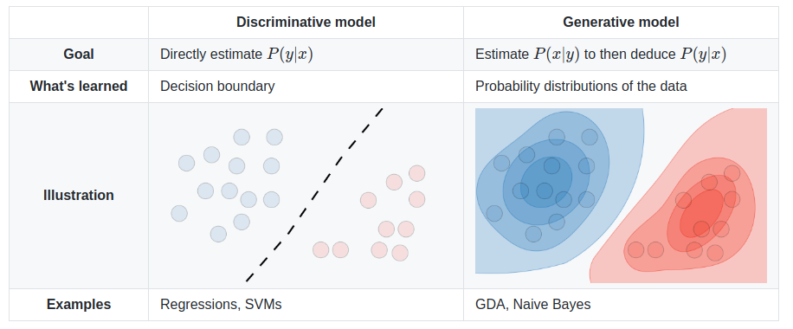
Discriminative Model & Generative Model
*** Don’t get confused with the usage of Classification & Clustering.
They are somewhat different, in terms of what is to be emphasized.
The context matters.

Slide 16
Discriminative Model & Generative Model
… the terminology is constitutional because a generative model can be used to "generate" random instances (outcomes), either of an observation and target, or of an observation x given a target value y, while a discriminative model or discriminative classifier (without a model) can be used to "discriminate" the value of the target variable Y, given an observation x. The difference between "discriminate" (distinguish) and "classify" is subtle, and these are not consistently distinguished.
~ Adapted from Wikipedia

Slide 17
Jargons Clarification
Unsupervised Learning
Clustering Task
Discriminative Model & Generative Model
Dimensionality Reduction & Manifold Learning

Slide 18
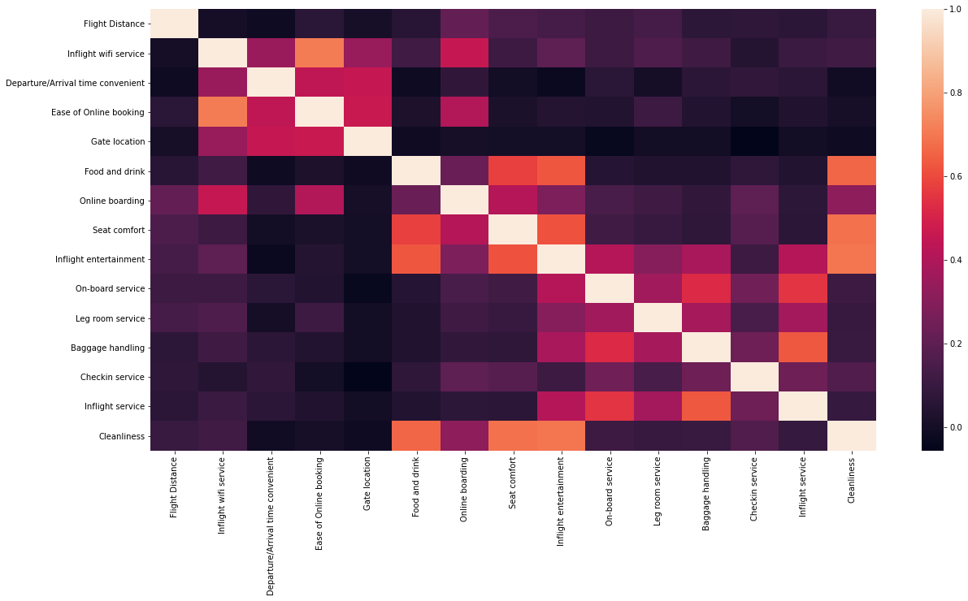
Recall: HW 1 (Airline Passenger Satisfaction)

Slide 19
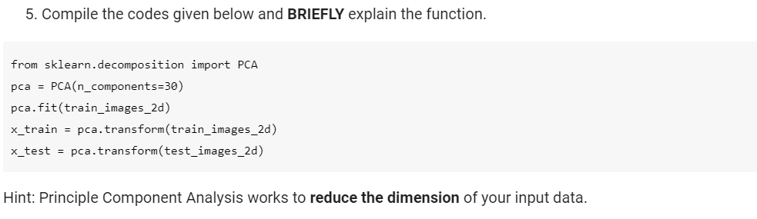
Recall: HW 2 (PCA in MNIST Dataset)

Slide 20

Dimensionality Reduction
Dimensionality reduction, or dimension reduction, is the transformation of data from a high-dimensional space into a low-dimensional space so that the low-dimensional representation retains some meaningful properties of the original data, ideally close to its intrinsic dimension.
~ Adapted from Wikipedia

Slide 21
Factor Analysis
Factor analysis is a statistical method used to describe variability among observed, correlated variables in terms of a potentially lower number of unobserved variables called factors.

Slide 22
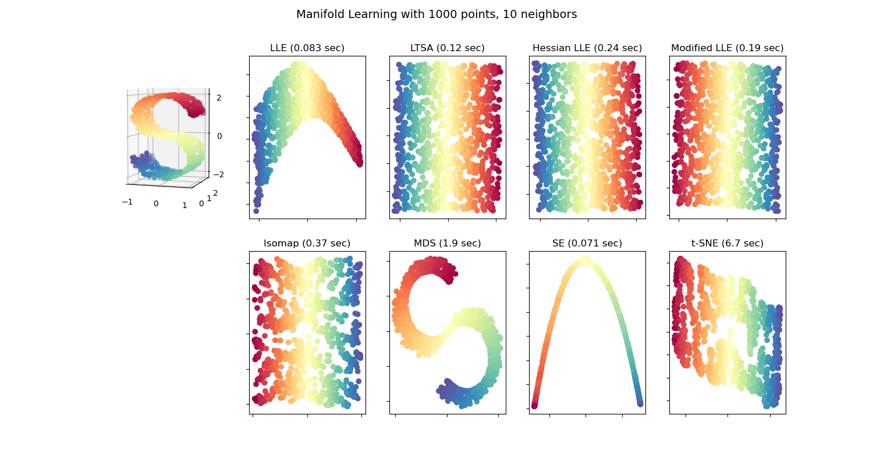
Recall: Manifold Learning and t-SNE

Slide 23
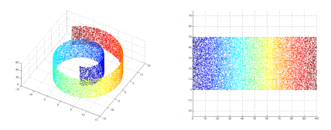
Manifold Learning as Non-Linear Dimensionality Reduction
High-dimensional data, …, can be difficult to interpret. One approach to simplification is to assume that the data of interest lie on an embedded non-linear manifold within the higher-dimensional space. If the manifold is of low enough dimension, the data can be visualized in the low-dimensional space.
~ Adapted from Wikipedia

Slide 24
Outline
Jargons Clarification
Clustering Task & Generative Model
Dimensionality Reduction
Structural Modelling

Slide 25
Clustering Task & Generative Modelling
K-Means Clustering
DBSCAN
Gaussian Mixture Model (Generative Model)
Topic Models (Generative Models)

Slide 26
Clustering Task & Generative Modelling
K-Means Clustering
DBSCAN
Gaussian Mixture Model (Generative Model)
Topic Models (Generative Models)

Slide 27
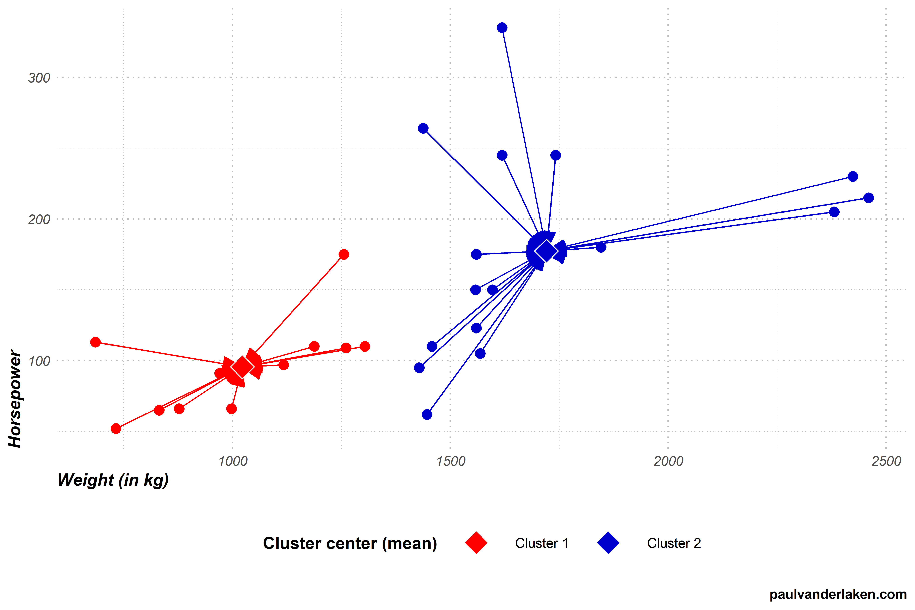
K-Means as Euclidean-Distance-Based Clustering

Slide 28
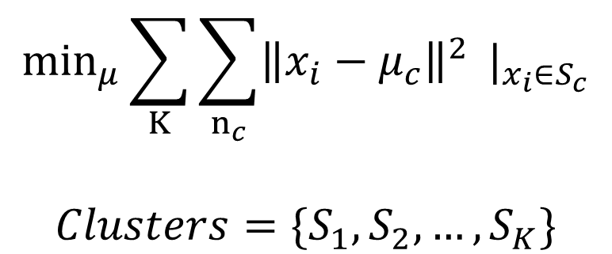
Optimization problem of K-means Clustering
$$\min_{μ}\sum_{K}{\sum_{n_{c}}{{\left\|x_{i}−μ_{c}\right\|}^{2}}} |_{x_{i}∈S_{c}}$$
$$Clusters=\{S_{1},S_{2},…,S_{K}\}$$

Slide 29
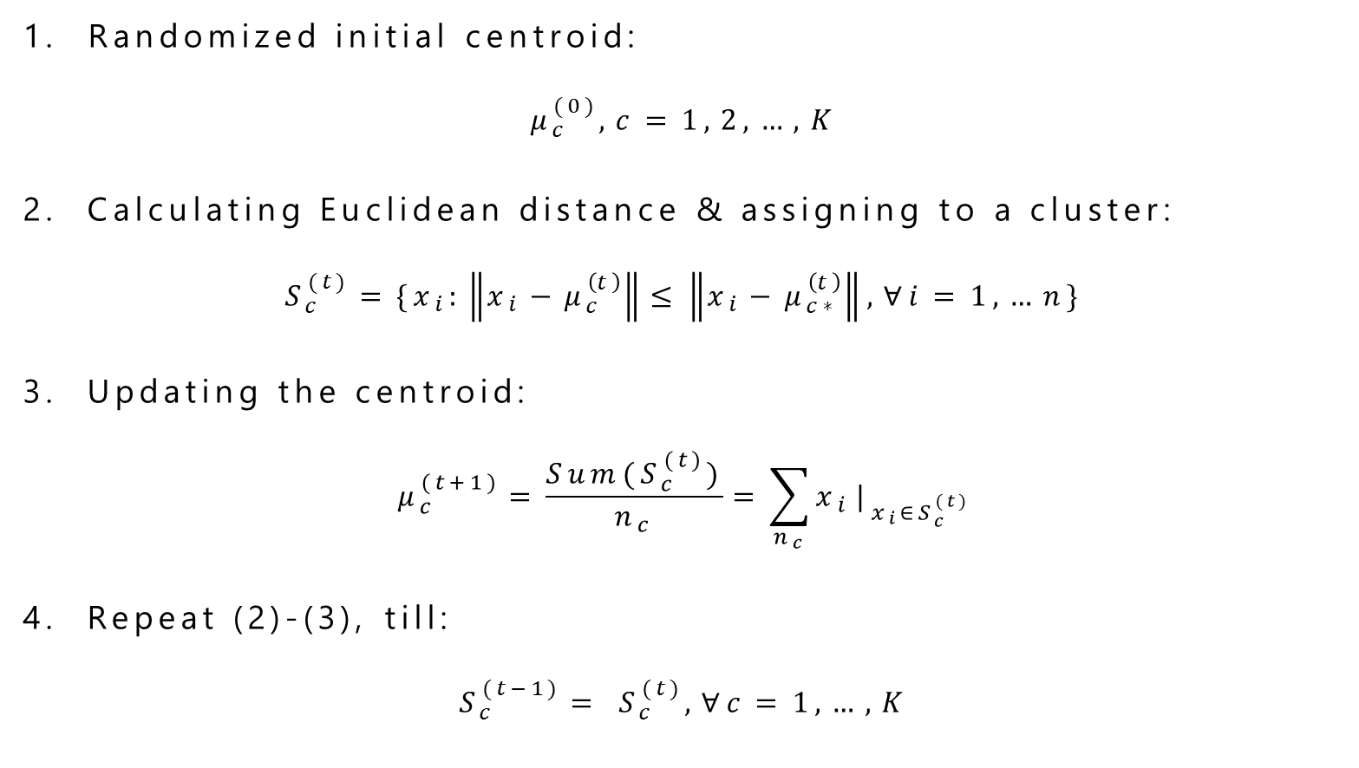
Step-by-step Deconstruction of K-means Optimization
Randomized initial centroid:
$$μ_{c}^{(0)}, c=1, 2, …, K$$
2. Calculating Euclidean distance & assigning to a cluster:
$$S_{c}^{(t)}=\{x_{i}:\left\|x_{i}−μ_{c}^{\left(t\right)}\right\|≤\left\|x_{i}−μ_{c∗}^{\left(t\right)}\right\|, ∀i=1,…n\}$$
3. Updating the centroid:
$$μ_{c}^{(t+1)}=\frac{Sum(S_{c}^{(t)})}{n_{c}}=\sum_{n_{c}}{x_{i}}|_{x_{i}∈S_{c}^{(t)}}$$
4. Repeat (2)-(3), till:
$$S_{c}^{(t−1)}= S_{c}^{(t)}, ∀c=1, …, K$$

Slide 30
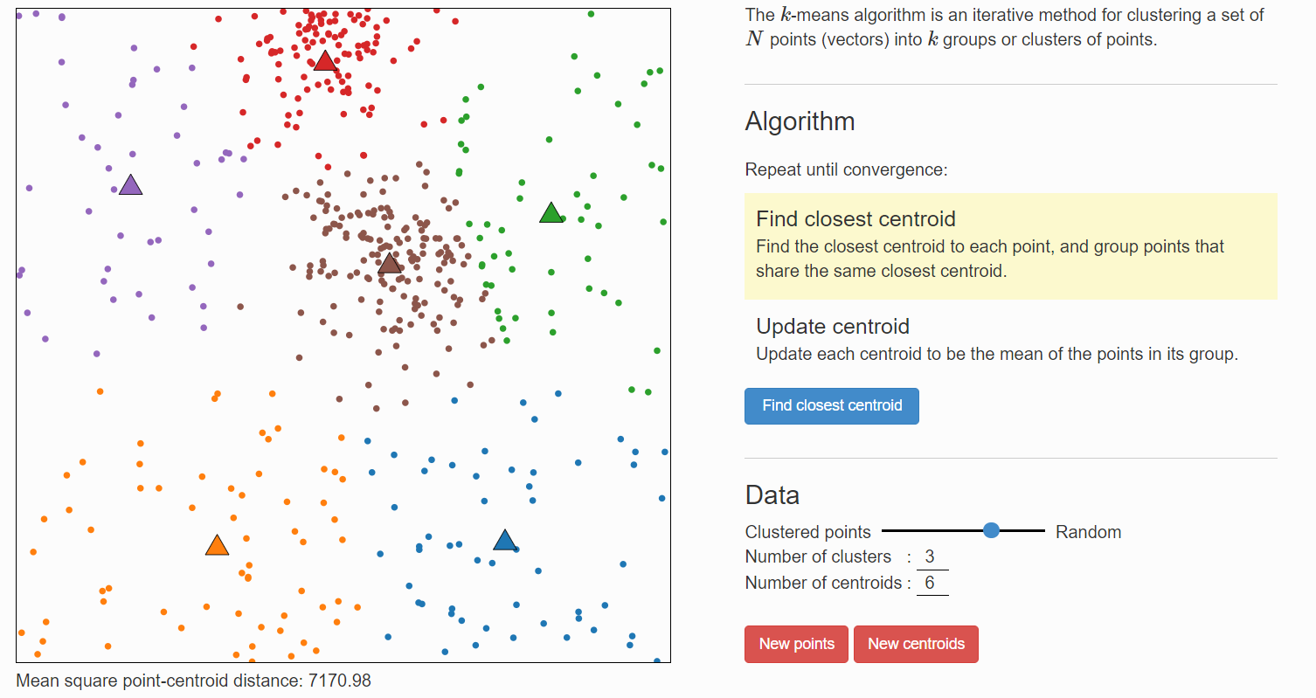
Visualizing K-Means Clustering

Slide 31
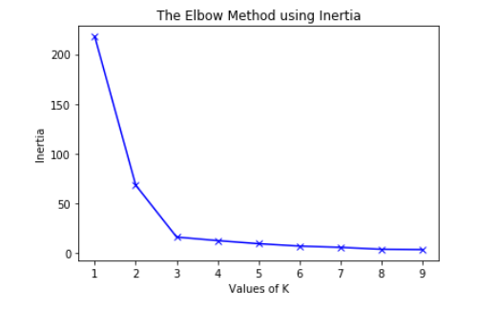
How many clusters should be?
Inertia = sum of squared-distance of each data points with its respective centroids

Slide 32
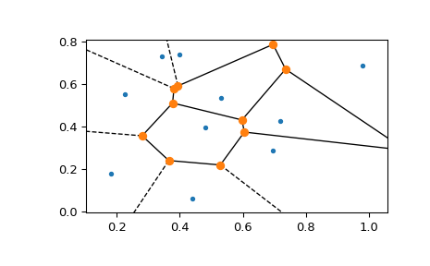
Centroid & Voronoi Polygon

Slide 33
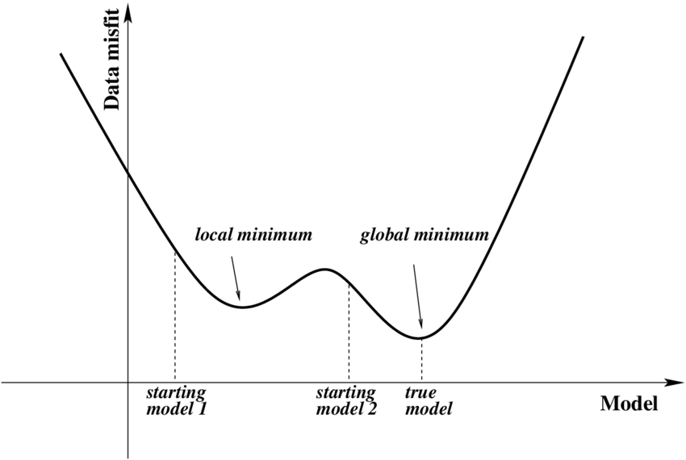

Slide 34
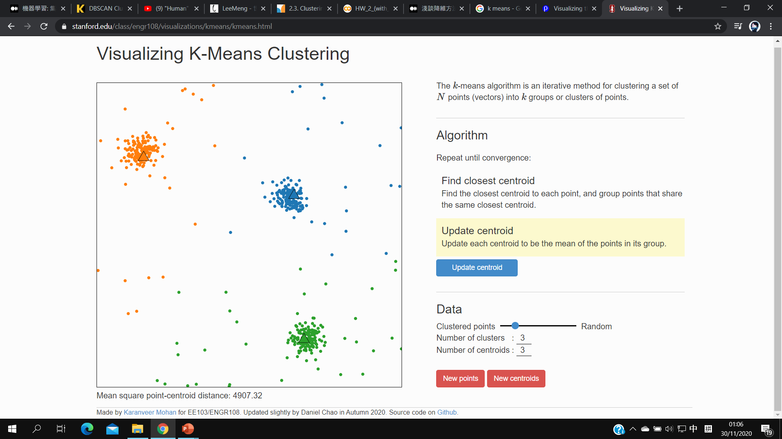
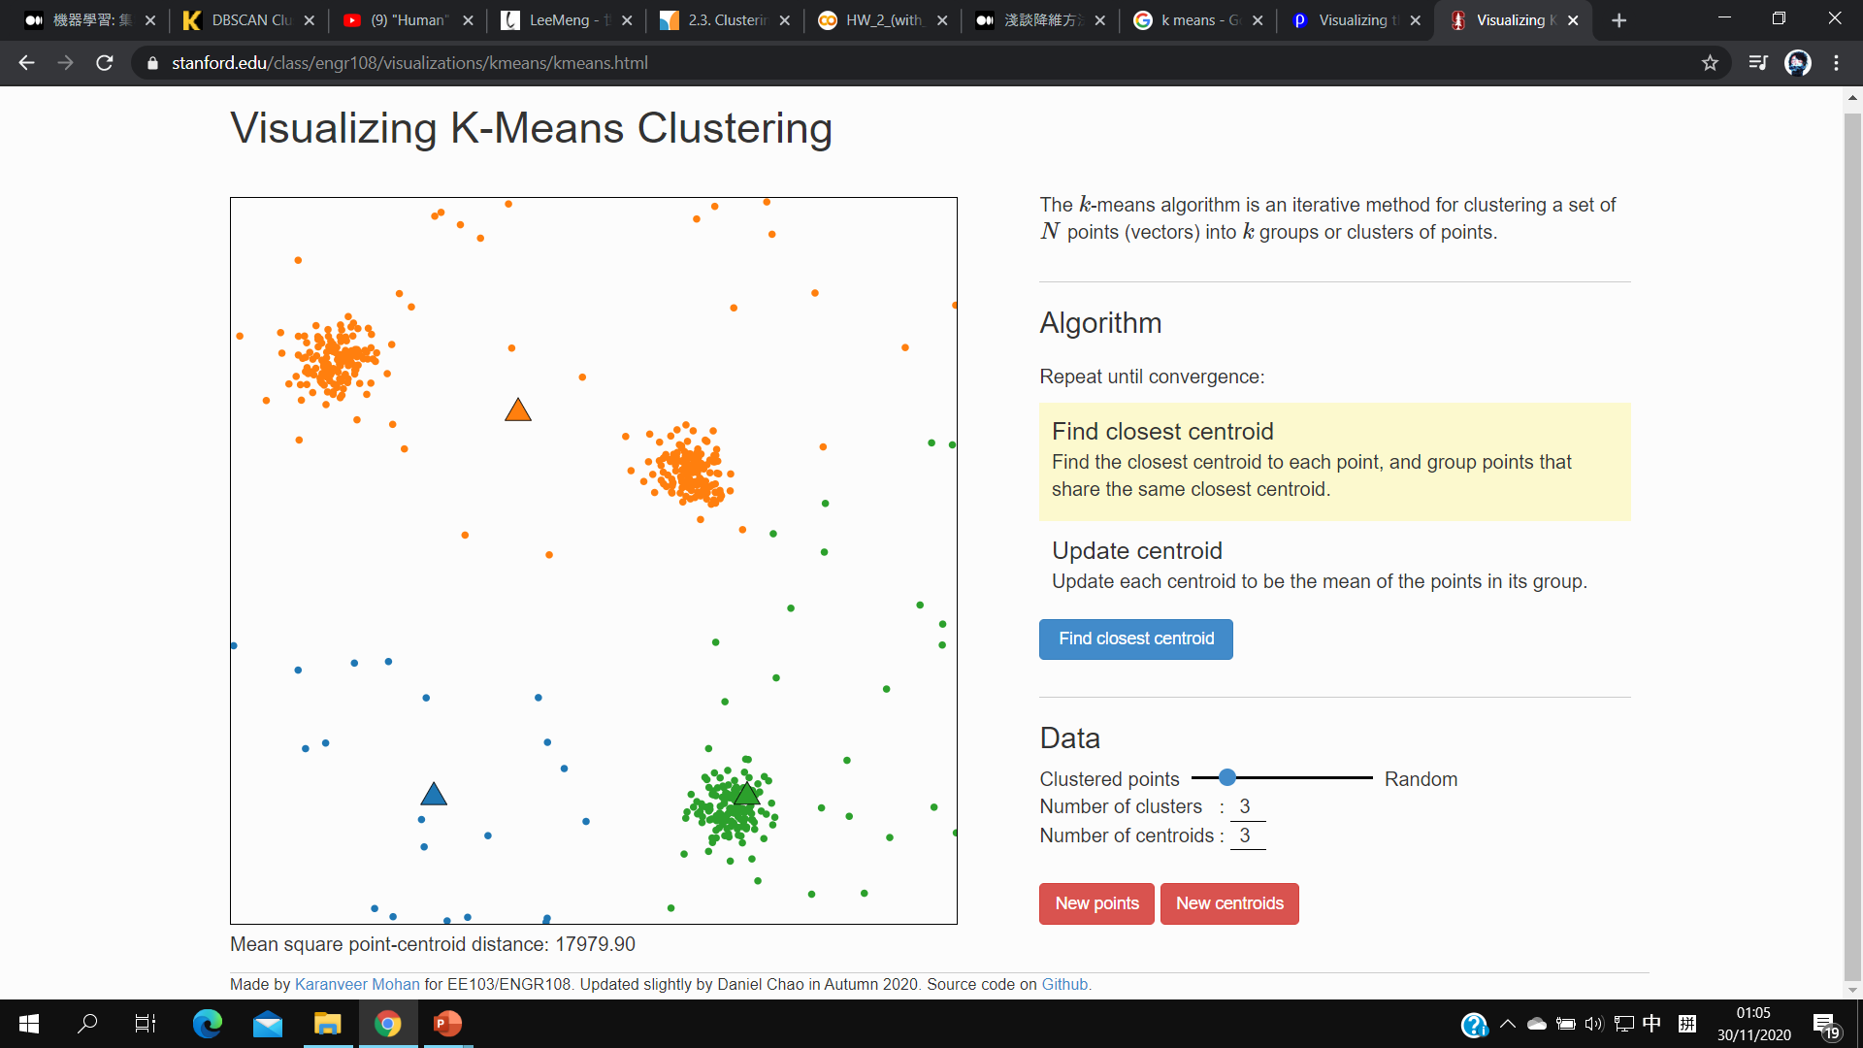
K-Means Variability & Local Minimum

Slide 35
In case of trapping in local minimum…
Repeat the whole process with different sets of initial centroids and opt with the Inertia.
The lower the inertia, the more likely it’s the best solution.

Slide 36
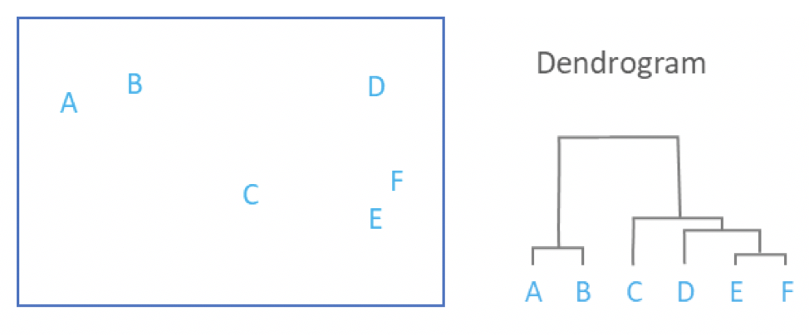
Hierarchical Clustering Analysis

Slide 37
Clustering Task & Generative Modelling
K-Means Clustering
DBSCAN
Gaussian Mixture Model (Generative Model)
Topic Models (Generative Models)

Slide 38
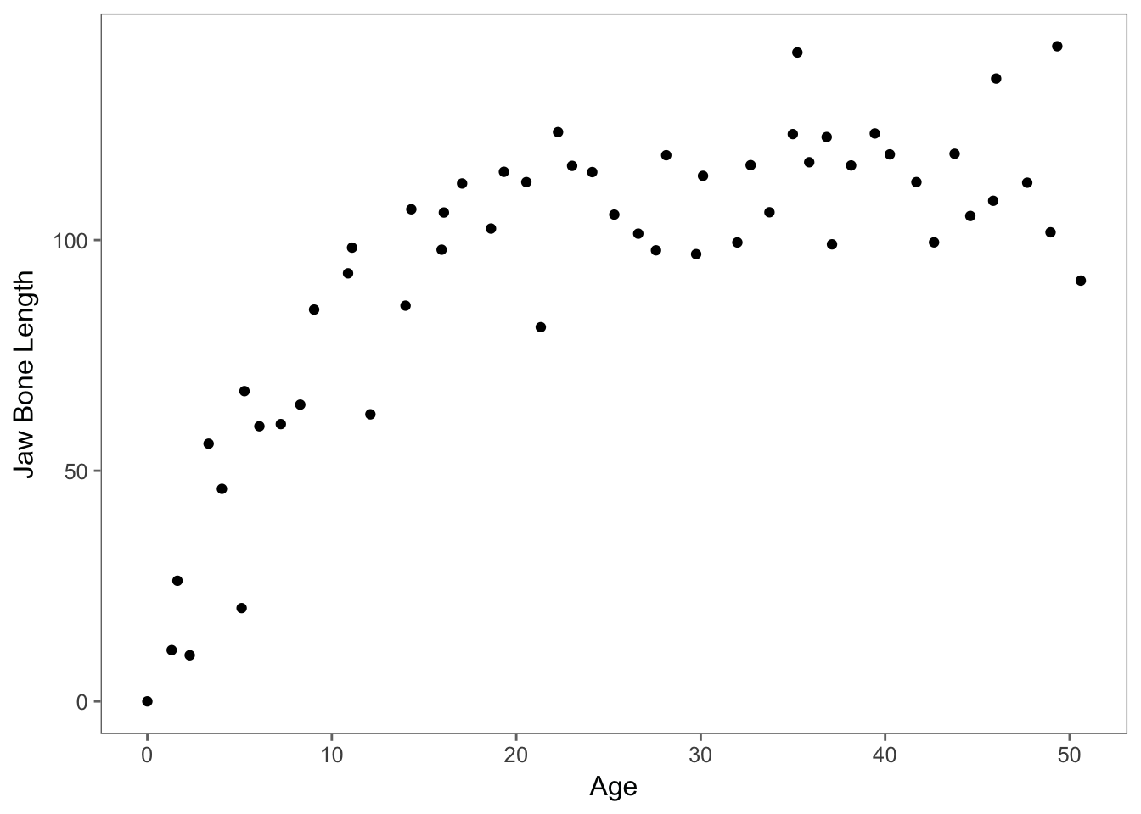
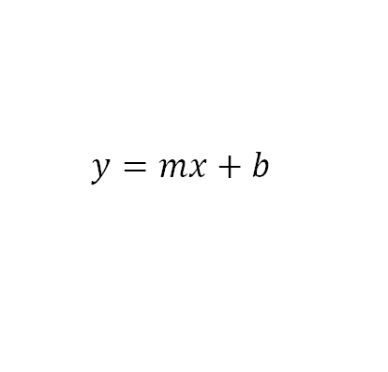
Recall：
Model-based
/ Parametric Approach

Slide 39
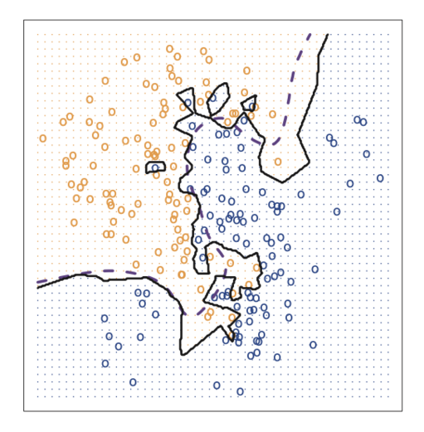
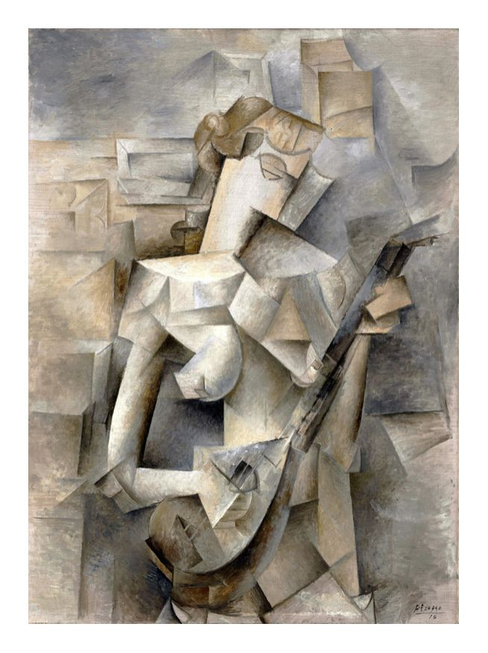
Recall: Instance-based / Non-parametric Approach
Girl with a Mandolin – Pablo Picasso 1910

Slide 40
Roughly speaking, K-means clustering is an example of model-based unsupervised learning while the learning of DBSCAN is based on the instances.

Slide 41

Intuitive Understanding of Density-Based Spatial Clustering of Application with Noise (DBSCAN)

Slide 42
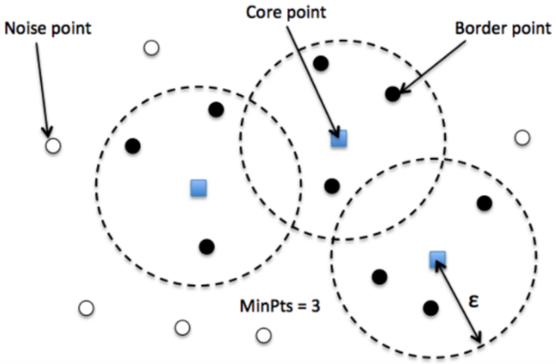
Intuitive Understanding of Density-Based Spatial Clustering of Application with Noise (DBSCAN)
Hyperparameters of DBSCAN: minPts, ε & Distance function

Slide 43
Clustering Task & Generative Modelling
K-Means Clustering
DBSCAN
Gaussian Mixture Model (Generative Model)
Topic Models (Generative Models)

Slide 44
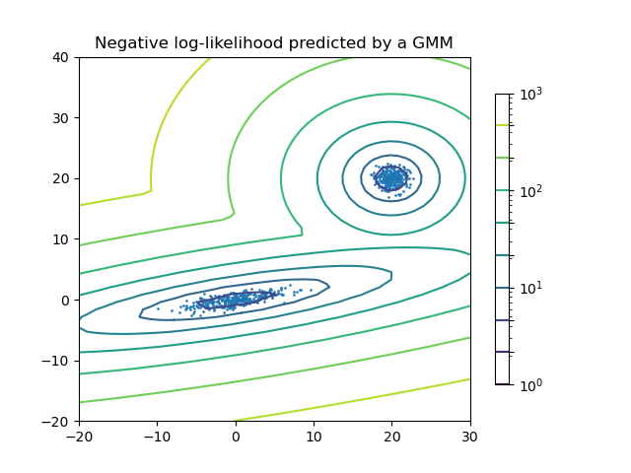
Intuitive Understanding of Gaussian Mixture Model (GMM)

Slide 45
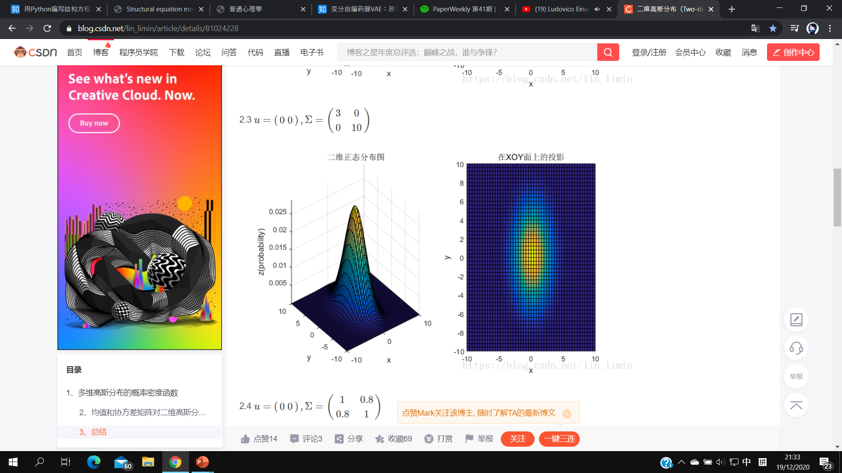
Multidimensional Gaussian Distribution

Slide 46
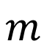
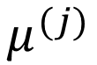
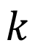
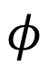
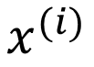
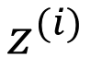
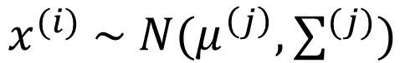
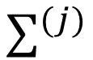
Plate Notation of (Frequentistic) Gaussian Mixture Model
$$φ$$
$$z^{(i)}$$
$$x^{(i)}$$
$$x^{(i)} \sim N(μ^{\left(j\right)},∑^{(j)})$$
$$m$$
$$μ^{(j)}$$
$$∑^{(j)}$$
$$k$$

Slide 47
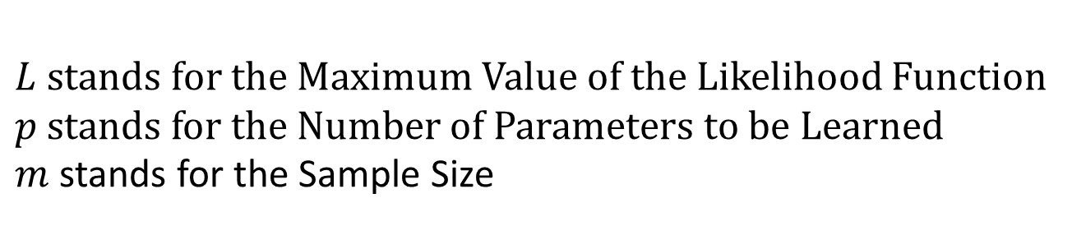
Selection of the Number of Clusters
with Information Criterion
$$Akaike Information Criterion, AIC=2p − 2log\left(L\right)$$
$$Bayesian Information Criterion, BIC=log\left(m\right)p − 2log\left(L\right)$$
$L stands for$ the Maximum Value of the Likelihood Function
$p$ stands for the Number of Parameters to be Learned
$m$ stands for the Sample Size
The lower the Information Criterion the better.

Slide 48
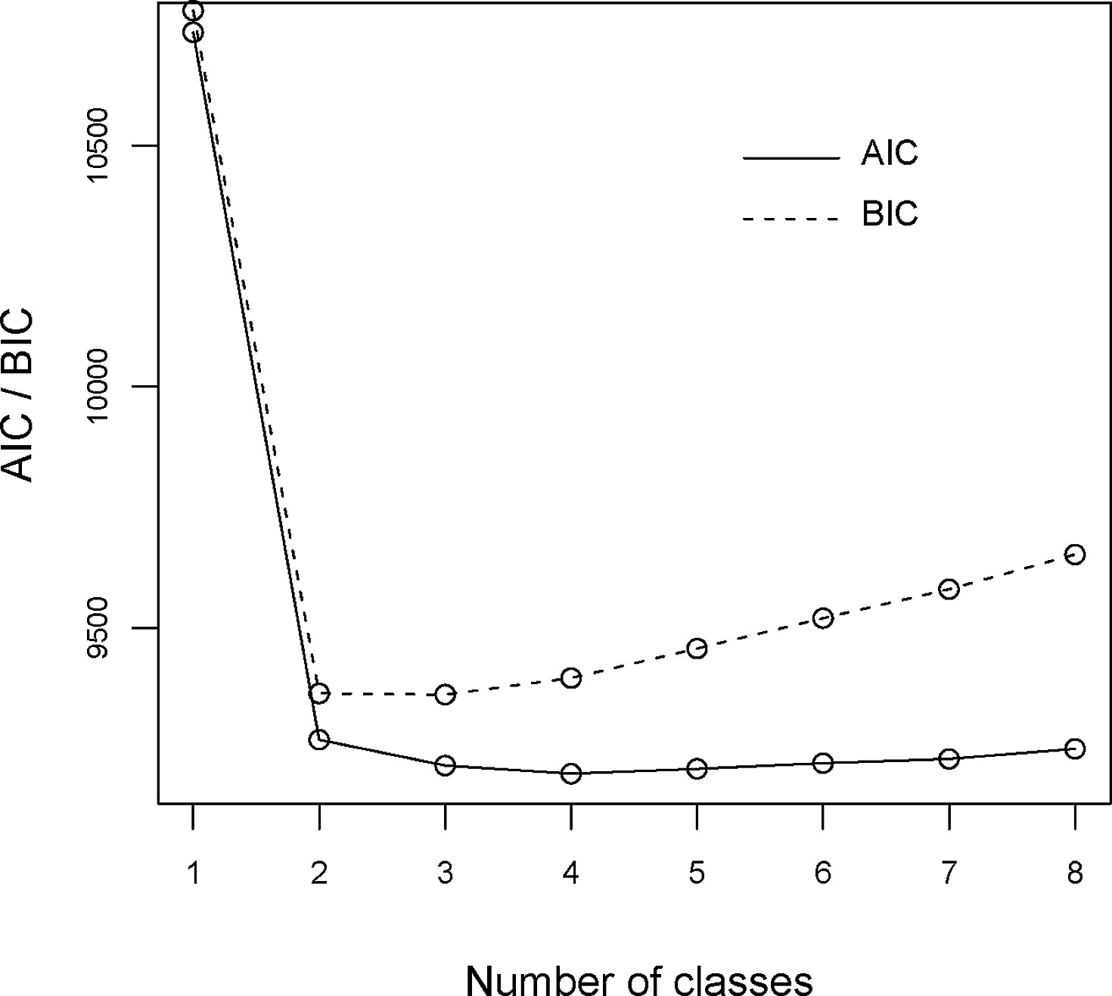
Selection of the Number of Clusters
with Information Criterion

Slide 49
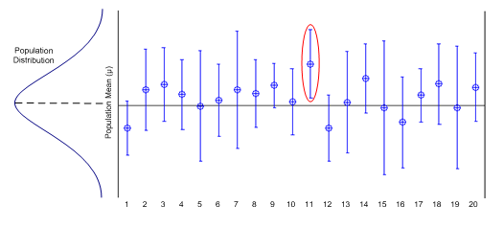
Frequentistic Statistics

Slide 50
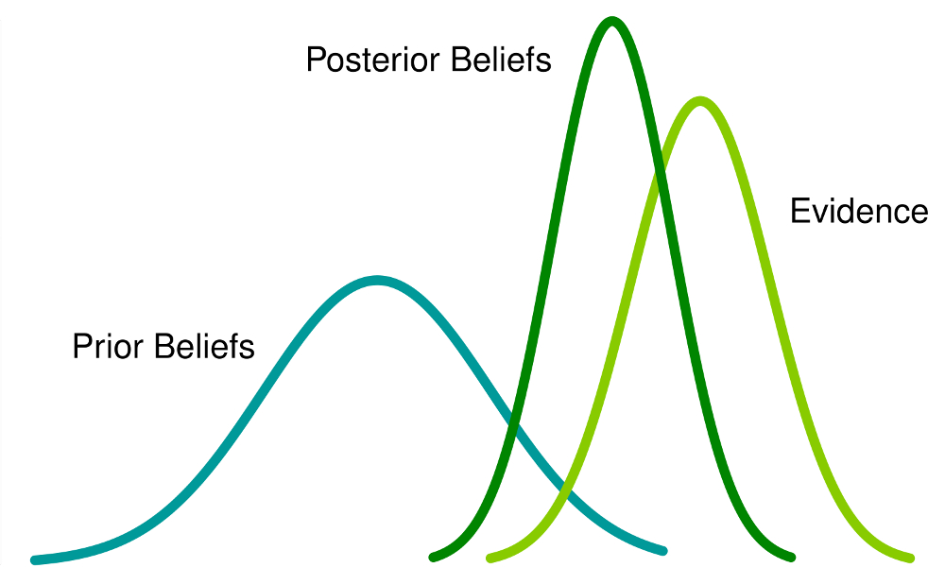
Bayesian Statistics

Slide 51
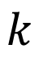
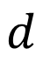
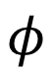
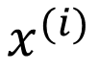
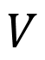
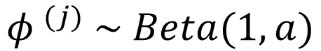
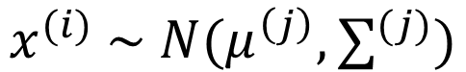
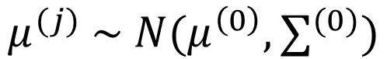








Plate Notation of (Bayesian) Gaussian Mixture Model
$${φ }^{(j)} \sim Beta(1,a)$$
$$x^{(i)} \sim N(μ^{\left(j\right)},∑^{(j)})$$
$$a$$
$$φ$$
$$z^{(i)}$$
$$x^{(i)}$$
$$∑^{(j)}\sim Wishart(d,V)$$
$$m$$
$$μ^{(0)}$$
$$d$$
$$μ^{(j)} \sim N(μ^{\left(0\right)},∑^{(0)})$$
$$μ^{(j)}$$
$$∑^{(j)}$$
$$∑^{(0)}$$
$$k$$
$$V$$

Slide 52
Clustering Task & Generative Modelling
K-Means Clustering
DBSCAN
Gaussian Mixture Model (Generative Model)
Topic Models (Generative Models)

Slide 53


Slide 54

Plate Notation of Latent Dirichlet Allocation (LDA)

Slide 55

Dirichlet Distribution and “Cencentration”

Slide 56

Recall: PyLDAViz

Slide 57

Bayesian Estimation
& Markov-Chain Monte Carlo (MCMC) Method
*** to be more specific, the Gibb’s Sampling

Slide 58
The Development of GMM & Topic Modelling
On GMM
Gaussian Mixture Model
Bayesian Gaussian Mixture Model
On Topic Modelling
Unigram Model
Mixture of Unigram Model
Bayesian Unigram Model
Singular Value Decomposition (SVD) & Latent Semantic Analysis (LSA)
Probabilistic Latent Semantic Analysis (pLSA) – Hofmann, 1999
Latent Dirichlet Allocation (LDA) – Blei, 2003
Hierarchical Latent Dirichlet Allocation (hLDA) – Teh, 2005

Slide 59
Outline
Jargons Clarification
Clustering Task & Generative Model
Dimensionality Reduction
Structural Modelling

Slide 60
Dimensionality Reduction
Curse of Dimensionality
Principal Component Analysis (PCA) & Autoencoder (AE)
Variational Autoencoder (VAE, which is a Generative Model)
Generative Adversarial Networks (GANs)
Manifold Learning (t-SNE)

Slide 61
Dimensionality Reduction
Curse of Dimensionality
Principal Component Analysis (PCA) & Autoencoder (AE)
Variational Autoencoder (VAE, which is a Generative Model)
Generative Adversarial Networks (GANs)
Manifold Learning (t-SNE)

Slide 62

Sparse Samples in High Dimensional Space

Slide 63



Failure of Distance function in High Dimensional Space
$Volume of Sphere= \frac{4}{3} πr^{3}= \frac{2r^{3}π^{\frac{3}{2}}}{3Γ(\frac{3}{2})}$
$Volume of Hypersphere= \frac{2r^{N}π^{\frac{N}{2}}}{NΓ(\frac{N}{2})}$,
Where:
N = Dimensionality,
$Γ(⋅)$ is a Gamma function
$$Volume of Cube= {(2r)}^{3}$$
$$Volume of Hypercube= {(2r)}^{N}$$

Slide 64

Gamma Function

Slide 65

Failure of Distance function in High Dimensional Space
$$\lim_{N→∞}{\frac{{Volume}_{hypersphere}}{{Volume}_{hypercube}}}=\frac{π^{\frac{N}{2}}}{N2^{N−1}Γ(\frac{N}{2})}=0$$
$$\lim_{N→∞}{\frac{{Distance}_{A}−{Distance}_{B}}{{Distance}_{A}}}=0$$
The Distance indicated is Euclidean Distance
(a.k.a Mahalanobis Distance, smt. to do with Chi-square Distribution)

Slide 66
Dimensionality Reduction
Curse of Dimensionality
Principal Component Analysis (PCA) & Autoencoder (AE)
Variational Autoencoder (VAE, which is a Generative Model)
Generative Adversarial Networks (GANs)
Manifold Learning (t-SNE)

Slide 67
Principle Component Analysis & Variance Preservation

Slide 68




Linear Algebra on Projection
$$Length of Projection= \left\|a\right\|cosθ$$
$$Direction of Projection= \frac{\vec{u}}{\left\|u\right\|}=Unit vector of \vec{u}$$
$$Projection of \vec{a}=\left\|a\right\|cosθ\frac{\vec{u}}{\left\|u\right\|}$$
$$=\left\|a\right\|∙\frac{\left\langle \vec{a},\vec{u}\right\rangle }{\left\|a\right\|\left\|u\right\|}∙\frac{\vec{u}}{\left\|u\right\|}$$
$$= \frac{\left\langle \vec{a},\vec{u}\right\rangle }{{\left\|u\right\|}^{2}}∙\vec{u}$$
Where $\left\langle \vec{a},\vec{u}\right\rangle = {\vec{a}}^{T}\vec{u}$ = ${\vec{u}}^{T}\vec{a}$

Slide 69

Defining An
Optimization Problem

Slide 70

Lagrangian Optimization
& First Order Conditions

Slide 71

Singular Value Decomposition
(SVD)

Slide 72

Calculation of
eigenvalues and eigenvectors

Slide 73
Proof of SVD

Slide 74

Orthonormality of the Principle Components
& the Orthogonal Matrix
Probabilistically, it’s assumed that there’s no correlation between each PCs.

Slide 75

Further Reading – SVD & LDA as a Psychometric Approach
Mining big data to extract patterns and predict real-life outcomes. - Kosinski et al.
The End of Privacy | Michal Kosinski | Talks at Google

Slide 76

Linear Autoencoder and PCA

Slide 77

Autoencoder as Nonlinear Dimension Reduction

Slide 78


Recall: Matrix Representation of a Singular Perceptron
$$\left[\begin{matrix}v_{1} \\ v_{2}\end{matrix}\right]$$
$Output= φ\left(\left[\begin{matrix}v_{1} \\ v_{2}\end{matrix}\right]\right)$, where nonlinearity is introduced

Slide 79
Dimensionality Reduction
Curse of Dimensionality
Principal Component Analysis (PCA) & Autoencoder (AE)
Variational Autoencoder (VAE, which is a Generative Model)
Generative Adversarial Networks (GANs)
Manifold Learning (t-SNE)

Slide 80

White Noise

Slide 81



Probability Distribution
圖像作爲數值資料，既然其數值排列不是隨機的，那麽必然存在著某種高維，複雜（難以被表示）的概率分佈（狗狗分佈）

Slide 82




HARLEQUIN'S CARNIVAL, 1924-25
Blue II
Joan Miro (1893-1983)
LA Nuit, 1953

Slide 83


印象派音樂與五聲音階（Pentatonic Scales）
Maurice ravel (1875-1937)

Slide 84

所謂風格，在數學上可以是某個概率分佈的體現

Slide 85

Variational Autoencoder as Generative Model

Slide 86

Variational Inference as
A Bayesian Approximation Method

Slide 87


Slide 88


Kullback-Leibler Divergence

Slide 89

Likelihood-Prior Balance

Slide 90

Relationship Between
Autoencoder &
Variational Autoencoder

Slide 91


Slide 92


Slide 93

We note the Likelihood-Prior Balance in the formulation of VAE again.

Slide 94


Slide 95


Slide 96

The Architect of VAE

Slide 97


Slide 98

Variational Autoencoder in Parameters Estimation of
Psychometric Model （IRT）
Variational Item Response Theory: Fast, Accurate, and Expressive
Mike Wu, Richard L. Davis, Benjamin W. Domingue, Chris Piech, Noah Goodman

Slide 99



Slide 100
Dimensionality Reduction
Curse of Dimensionality
Principal Component Analysis (PCA) & Autoencoder (AE)
Variational Autoencoder (VAE, which is a Generative Model)
Generative Adversarial Networks (GANs)
Manifold Learning (t-SNE)

Slide 101

Generative Adversarial Networks
Ian J. Goodfellow, Jean Pouget-Abadie, Mehdi Mirza, Bing Xu, David Warde-Farley, Sherjil Ozair, Aaron Courville, Yoshua Bengio

Slide 102


GANs & Deep Fake
You’re standing before Daenerys Stormborn of the House Targarven, the First of Her Name, the Unburnt, Queen of Meereen, Queen of the Andals and the Rhoynar and the First Men, Lord of the Seven Kingdoms, Protector of the Realm, Khaleesi of the Great Grass Sea, Breaker of Shackles, Mother of Dragons.

Slide 103
Dimensionality Reduction
Curse of Dimensionality
Principal Component Analysis (PCA) & Autoencoder (AE)
Variational Autoencoder (VAE, which is a Generative Model)
Generative Adversarial Networks (GANs)
Manifold Learning (t-SNE)

Slide 104


Pablo Picasso, Portrait of Dora Maar, 1937
Recall: Dimension Reduction
& Cubism

Slide 105
t-distributed stochastic neighbor embedding (t-SNE) is a machine learning algorithm for visualization based on Stochastic Neighbor Embedding (SNE) originally developed by Sam Roweis and Geoffrey Hinton, where Laurens van der Maaten proposed the t-distributed variant. It is a nonlinear dimensionality reduction technique well-suited for embedding high-dimensional data for visualization in a low-dimensional space of two or three dimensions. Specifically, it models each high-dimensional object by a two- or three-dimensional point in such a way that similar objects are modeled by nearby points and dissimilar objects are modeled by distant points with high probability.
~ Adapted from Wikipedia

Slide 106
Outline of my Rationale (t-SNE)
SNE & Model Construction
Problems encountered with SNE & Remedies
Probability Distribution (Prior knowledge in knowing why t-Distribution matters.)
t-Distribution in handling Crowding Problem of SNE

Slide 107

SNE & Model Construction

Slide 108

About KL Divergence

Slide 109

About Perplexity

Slide 110

About Entropy & Cross Entropy

Slide 111

About Optimization
(Ignore this part if you wish)

Slide 112

(Ignore this part if you wish)

Slide 113

Problems encountered with SNE & Remedies

Slide 114


Slide 115


Probability Distribution

Slide 116


Slide 117


Slide 118

t-Distribution in handling
Crowding Problem of SNE

Slide 119

t-Distribution in handling
Crowding Problem of SNE

Slide 120

Optimization Process of t-SNE

Slide 121

Some Examples of t-SNE Visualization (LDA modelling)

Slide 122

Some Examples of t-SNE Visualization (Fashion MNIST)

Slide 123

Some Examples of t-SNE Visualization (Word Embedding)

Slide 124

Cultivate Intuition in Interpreting t-SNE Visualization
*** to be honest, t-SNE could be very misleading

Slide 125
Outline
Jargons Clarification
Clustering Task & Generative Model
Dimensionality Reduction
Structural Modelling

Slide 126
Structural Modelling
Structural Equation Modelling (SEM)
Structural Vector Autoregressive Model (SVAR)

Slide 127

Structural Modelling as
Wind Tracer
As the adage holds, A straw shows which way the wind blows.
***見微知著，一葉知秋etc.

Slide 128


Covariance Matrix & Structural Inference
Note the symmetricity of such matrices.

Slide 129
Structural Modelling
Structural Equation Modelling (SEM)
Structural Vector Autoregressive Model (SVAR)

Slide 130

SEM under the Framework of Classical Test Theory

Slide 131

SEM as a Combination of
Factor Analysis & Multiple Regression

Slide 132

Linear Structural Relations (LISREL) Notation

Slide 133

Structural Inference Based on Theoretical Presumption

Slide 134
Structural Modelling
Structural Equation Modelling (SEM)
Structural Vector Autoregressive Model (SVAR)

Slide 135


Recall: An ARIMA(p, d, q) Process
$$y_{t}= β_{1}y_{t−1} + …+ β_{p}y_{t−p}+ ε_{t} + θ_{t−1}ε_{t−1}+…+ θ_{t−q}ε_{t−q}$$
$$y_{t }\sim I(d)$$
$$ε_{t} \sim {}^{i.i.d}(μ, σ^{2})$$

Slide 136

VAR as Multivariate Time Series Model

Slide 137

Note the error term.

Slide 138

Impulse-Response Function (IRF)

Slide 139

Recall: Least Square Method & Squared-Error
Premise of such operation is that there’re no correlation between the error terms.

Slide 140
What if?
ǂ 0
In this case, we’re unable to infer the IRF as the shock itself is not a pure shock.

Slide 141

Cholesky (LDLT) Decomposition & Structural Shock
a.k.a Structural Shock

Slide 142

Structural VAR & Historical Decomposition

Slide 143

Christopher A. Sims
&
Vector Autoregressive Model (VAR)

Slide 144
Questionable Procedure: Exploratory Structural Modelling
“EDA is not “fishing” or “torturing” the data set until it confesses.”
“Because EDA endorses open-mindedness and triangulation, it is not a standalone approach. Rather, it complements traditional confirmatory data analysis (CDA) by generating a working hypothesis, as well as spotting outliers and assumption violations that might invalidate CDA.”
Adapted from Exploratory Data Analysis – Chong Ho Yu

Slide 145

Thank You
FOR WATCHING AND LISTENING

